Slide 1
Fuelmart & Subway June Safety Committee Meeting
Wednesday, June 17, 2020
2:00 pm

Slide 2
Attendance!!!
Please take a moment to add your name(s) in the comment section so I can get an accurate attendance record for today’s meeting.
Thank you!

Slide 3
May 13.2020 Review
Taking time to focus on what you are doing to prevent employee injuries.
Angie spoke to us about educating news hires; using experiences as learning tools

Slide 4
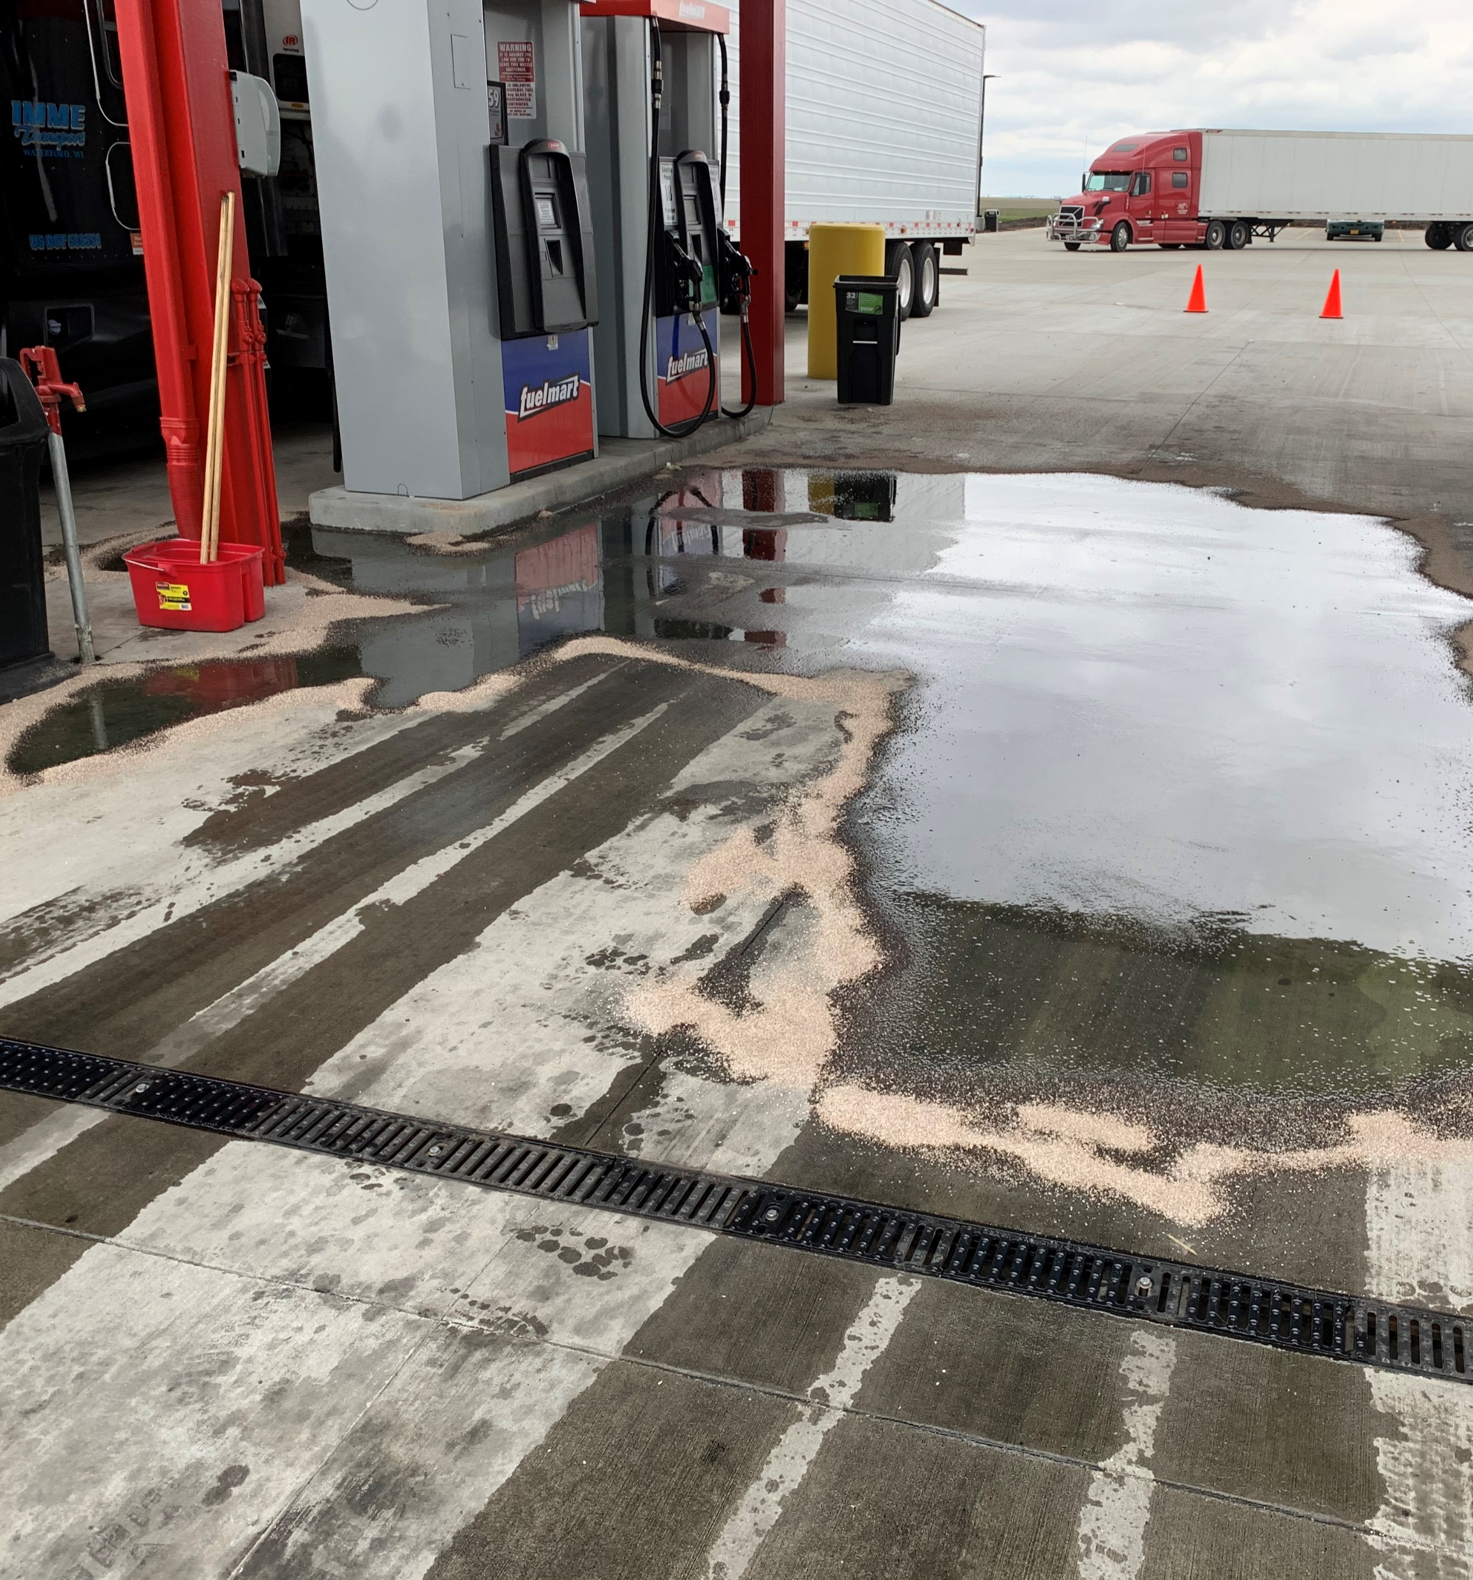
Incidents: 5.13.20 – 6.10.20
5.15.20 FM 767 Customer struck
5.20.20 FM 727 Employee slip/fall
5.20.20 FM 787 Customer spill (pump 18)
(see photo)
5.22.20 FM 727 Customer Fall (reporting procedures)
5.28.20 FM 645 Customer spill
5.29.20 FM 641 Customer Medical Emergency.
5.29.20 FM 706 Hose/Damage & Spill

Slide 5
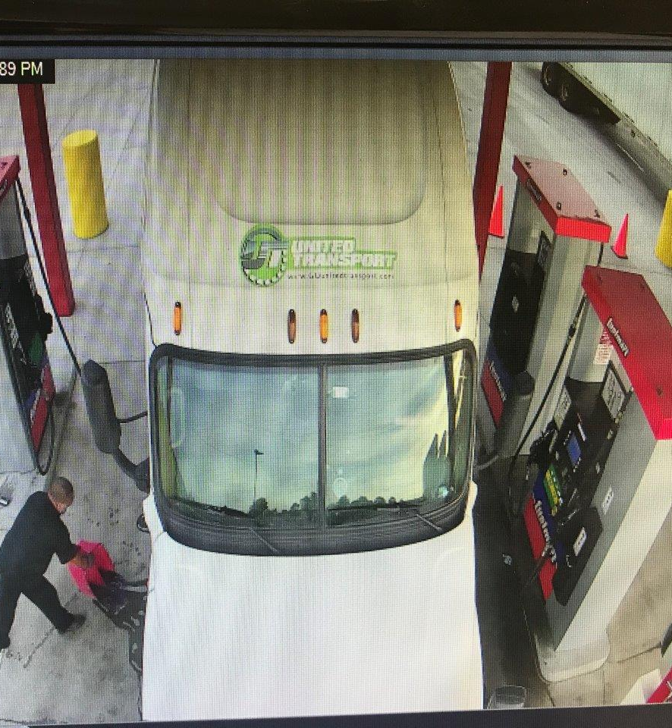
Incidents Continued
6.5.2020 FM 787 Customer spill (pump 20)
6.6.2020 FM 787 Customer spill (pump 20)
6.8.2020 FM 787 Customer spill (pump 20)
6.9.2020 FM 787 Customer spill (pump 20)
6.10.2020 FM Delivery Driver minor spill
6.11.2020 FM 783 Property Damage
6.13.20 FM 787 Customer spill (pump 20)
6.13.20 FM 787 Customer spill (pump 17)
6.13.20 FM 783 Customer Medical Issue

Slide 6
Incident Handling
Please refer to the Incident Guide when training your employees. It provides step by step instructions. I will include a copy when I send out your meeting minutes.
In the event of a spill, use oil dry to contain and absorb the spilled product and sweep up. If it is a considerable amount you can squeegee the product into your oil/water separator (ONLY IF YOU ARE 100% SURE IT IS A SEPARATOR and not a drain) then clean up remaining product with oil dry and broom. Do not use water to spray product into the separator, this adds the amount of fluid entering the separator which can lead to overflow and product then entering waterways.
Until the product is cleaned up, use your cone and/or caution tape to keep customers from walking/driving through the spill.
If your spill is larger than 6’X6’ or 5’X7’ you will need to contact Phillip to report the spill.
Any time a spill is too large to handle or entering a drain, ditch, manhole cover call Phillip immediately.

Slide 7
Incident reporting
The original witness/employee to an incident should be reporting directly to Phillip. His information along with the incident packets should be readily available to all employees.
When filling out your incident form only include the facts. Make no assumptions. If it is a question you don’t know the answer to write “unknown”.
If/When a customer comes in to report a spill. Please be sure to go outside and look for yourself to determine if Phillip needs notification. It is extremely important to view the spill just to verify for yourself no waterways are impacted. The reason for this is that Phillip has very limited time to notify the EPA.
When taking pictures of damage please be sure to take several pictures from different angles so that we can clearly see the damage.
We understand that incidents can be overwhelming, and it can be very busy. Please be sure to send in your incident forms in a timely manner. Our insurance requires us to submit claims within a certain amount of time of the incident.

Slide 8
Incident Training Points
Do you know where your incident Report form is?
Do you know what customer information you need? Name/Company/Contact info/Insurance
Do you know who to report an incident to for a spill/customer incident/Employee injury?
Do you know where the phone number is to report?
Do you know what to do when a customer reports a spill?

Slide 9
A note from your Safety Department
Monthly Safety Inspections should be filled out by employees. We’ve noticed overtime that the managers have taken over this task. Employees participating in doing the inspections will help educate where things are and keep and eye open for any defects.
Check your inventory on yellow caution tape. Let us know if you are low and we’ll get an order out to you asap.
Be sure to have a refresher with your employees on spill management/clean up
Provide a dialog for dealing with customers when an incident occurs such as when a spill is reported and you are busy, notify the customer you’re working with “so sorry, I’ll be right with you, I just need to be sure it’s nothing serious”. Or when getting information from a customer “I understand. I just need to get some information from you and we’ll get you on your way”. How you present it to the customer makes a huge difference.

Slide 10
Driver Concerns
5.19 Report of the flapper on Tank #1 not being accurate at Fuelmart 646. Todd already aware. Jimmy reported back the piece being replaced that day.

Slide 11
FuelMart & Subway 2020 Incident Totals
Company Total: 97
FuelMart & Subway Total: 66
Employee Injuries: 11
Property Damage and/or Vehicle Incidents: 18
Customer Spills: 25 (19 at fuel pumps)
Customer Injuries:4
“Other” Incidents: 8

Slide 13
July Safety Committee Meeting 7.22.20 2:00 pm

